Slide 1
A BLE-based multi-gateway network infrastructure with handover support for mobile BLE peripherals
SPEAKER : Jia-Wei Guo
ADVISOR: DR. HO-TING WU

Slide 2
Outline
Introduction
Primer on BLE and BLE over IPv6
Related work
A BLE-based multi-Gateway network infrastructure
Handover approaches
Implementation details
Evaluation
Conclusion
References

Slide 3
Introduction

Slide 4
Primer on BLE and BLE over IPv6
Bluetooth Low Energy (BLE) was released in 2011 as part of the Classic Bluetooth specification and both technologies have coexisted and evolved independently since then.
BLE operates in the 2.4 GHz band, utilizing frequencies between 2402 and 2480MHz. The used spectrum is divided into 40 channels, each employing a space of 2 MHz. These channels are divided into 3 primary advertisement channels and 37 connection-oriented channels.
BLE supports two different ways of communication : an advertising mode and a connection-oriented mode.

Slide 5
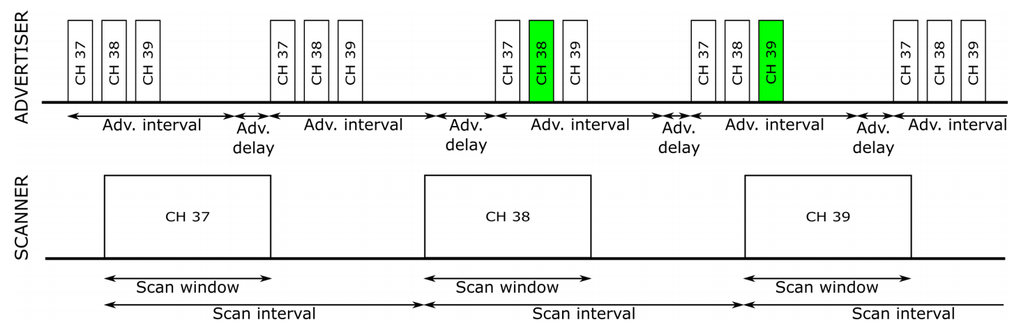
Primer on BLE and BLE over IPv6(cont’d)

Slide 6
Primer on BLE and BLE over IPv6(cont’d)

Slide 7
Related work

Slide 8
Evaluation
The performance of the handover process is predominantly impacted by two steps: disconnecting from the current GW and setting up a connection with the alternative GW.

Slide 9
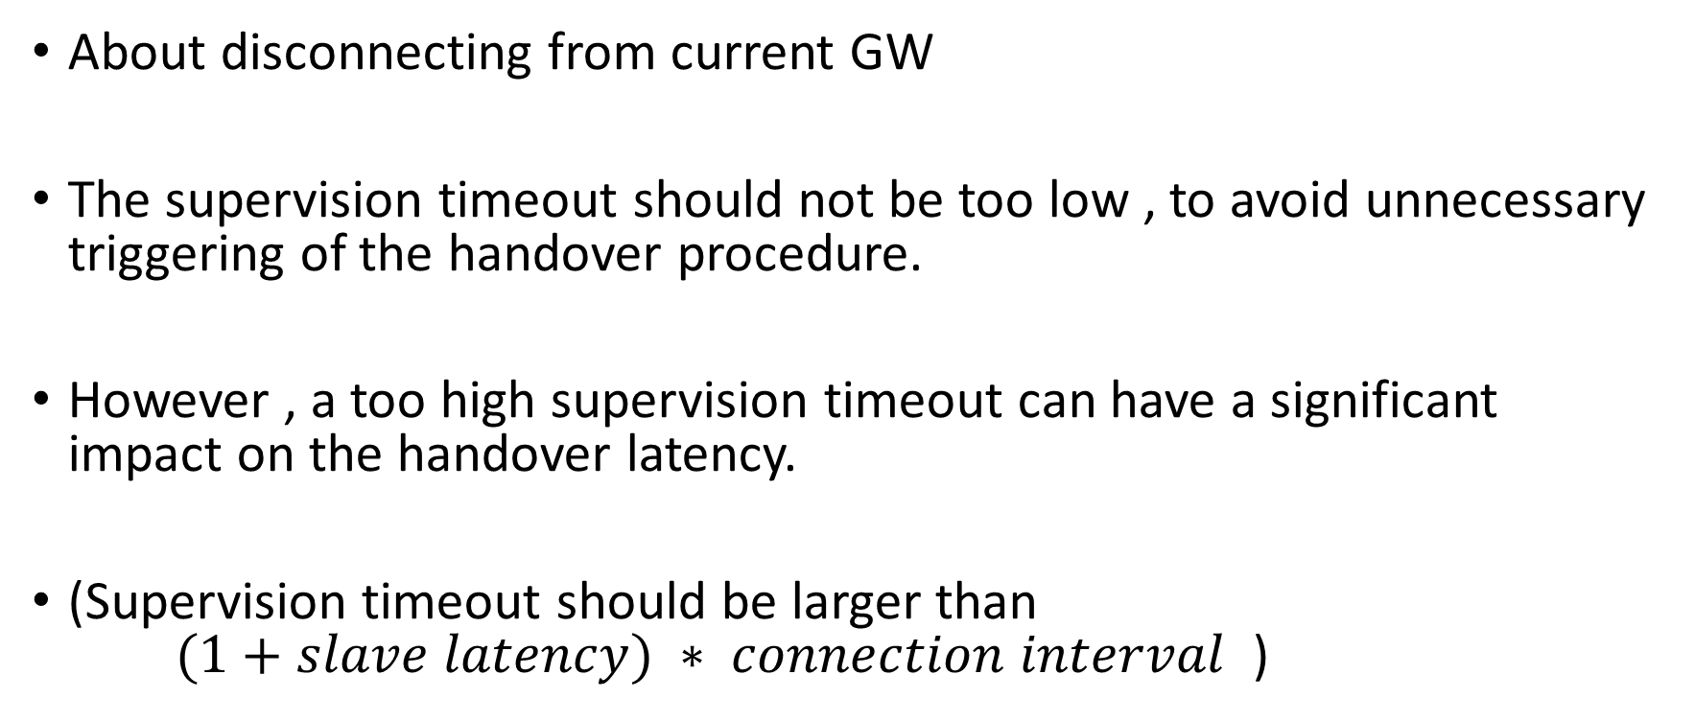
Evaluation : passive handover
About disconnecting from current GW
The supervision timeout should not be too low , to avoid unnecessary triggering of the handover procedure.
However , a too high supervision timeout can have a significant impact on the handover latency.
(Supervision timeout should be larger than $(1+slave latency) ∗ connection interval$ )

Slide 10
Evaluation : passive handover(cont’d)
About setting up a connection with the alternative GW
Once the BLE peripheral’s supervision timeout has timed out, it transitions back to the advertising state, broadcasting connectable advertisements at a certain advertising interval.
A GW that is not in a connection or still has room for another BLE connection, is in the initiating state and attempts to set up a connection upon receiving the connectable advertisements from the BLE peripheral.

Slide 11
Evaluation : passive handover(cont’d)
About BLE parameter combinations
The advertising interval should be smaller or equal to the scan window, because otherwise it cannot be guaranteed that the GW will be able to receive a connectable advertisement in an acceptable time window.
A higher scan duty cycle ( scan window/scan interval ) has a positive impact on the handover latency but a negative impact on the energy consumption of the GW.
Notes:
但使用連續scan可降低外圍設備的功耗，因為可較快接收到advertising。

Slide 12
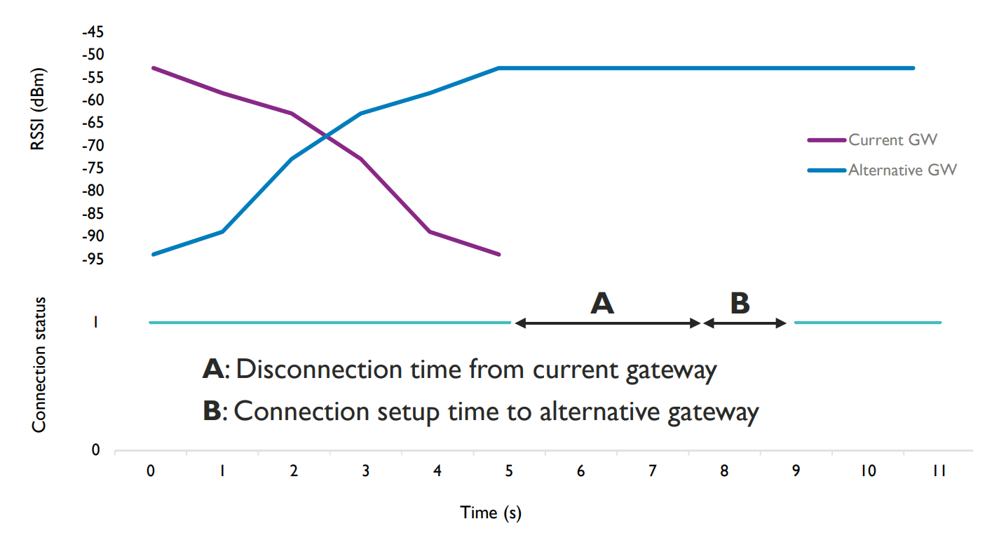
Evaluation : passive handover(cont’d)

Slide 13
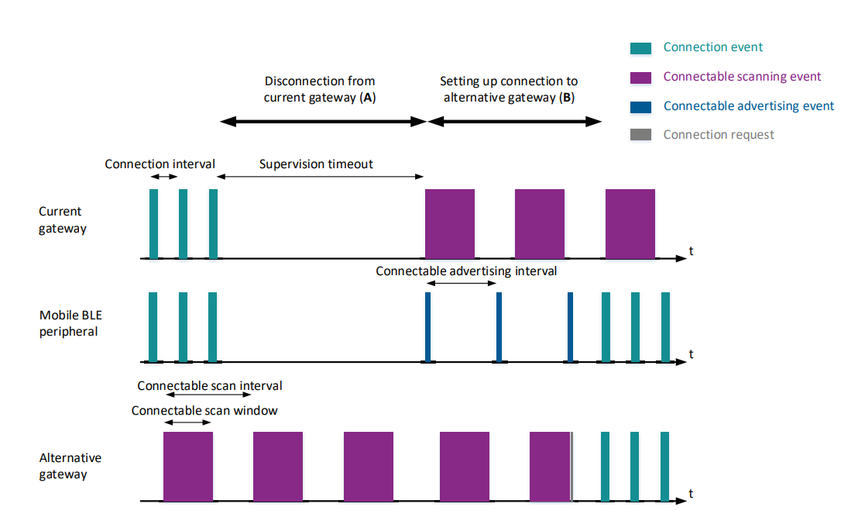
Evaluation : passive handover(cont’d)

Slide 14
Evaluation : active handover

Slide 15
Conclusion
In this paper, two architectures are proposed to realize a BLE-based multi-GW network infrastructure that is able to provide bidirectional connectivity to mobile BLE peripherals.
The IP based architecture offers seamless end-to-end IP connectivity between a mobile BLE peripheral and an existing IP network. It limits custom implementation needs, but requires more resources from the already constrained mobile BLE peripheral.

Slide 16
Conclusion(cont’d)
The non-IP based architecture requires less resources from the BLE peripheral as it employs native BLE communication towards the IoT gateway. However, custom implementation needs are much higher, as a dedicated controller is introduced within the existing network that needs to maintain the state of the infrastructure and the currently associated mobile BLE devices.

Slide 17
Conclusion(cont’d)
Next to this, two approaches are considered to perform handover within these solutions.
The passive handover approach does not need any extra implementation, but the handover latency can become quite high and a bad BLE connection is still maintained even if a better alternative GW is avail-able nearby.

Slide 18
Conclusion(cont’d)
Active handover offers a solution by proactively terminating a bad connection when a better alternative GW is available. As such, it can limit the handover latency. Asa downside, this approach requires more extensive custom implementation, implies a higher energy consumption and can limit the available throughput.

Slide 19
References
Mathias Baert, Pieterjan Camerlynck, Pieter Crombez, Jeroen Hoebeke, “A BLE-Based Multi-Gateway Network Infrastructure with Handover Support for Mobile BLE Peripherals” in IEEE Internatonal Conference on Mobile Adhoc and Sensor Systems (IEEE MASS 2019) , DOI: 10.1109/MASS.2019.00020
M. Nikodem, M. Bawiec, “Experimental Evaluation of Advertisement-Based Bluetooth Low Energy Communication”, MDPI Sensors 2020, DOI:10.3390/s20010107

